Slide 1

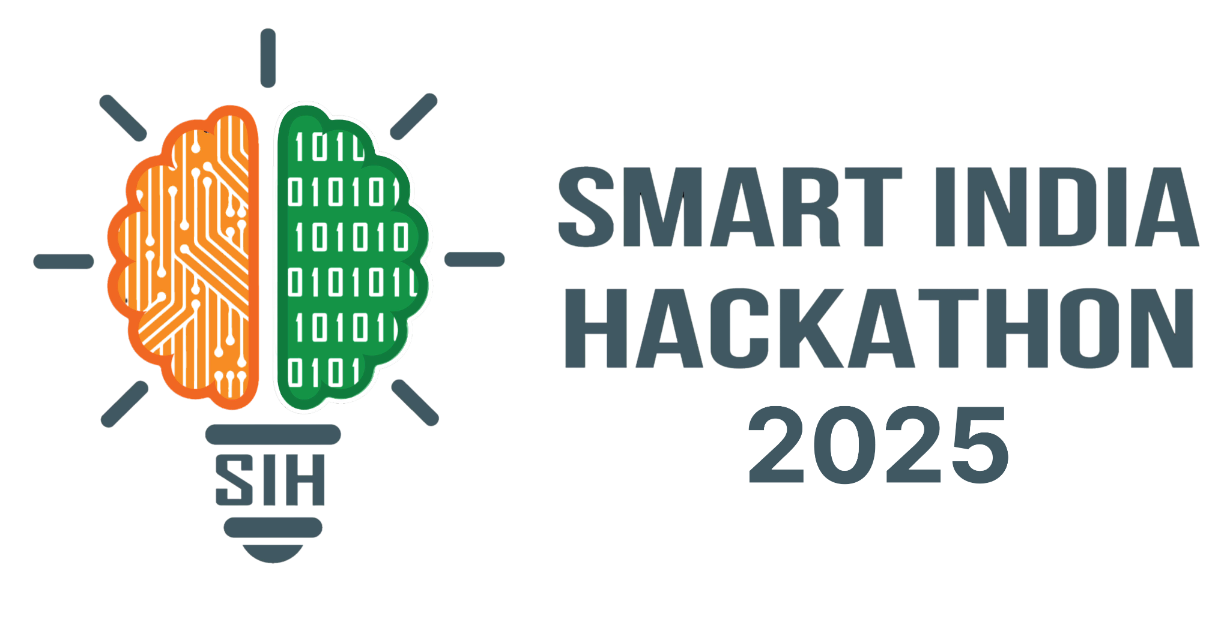
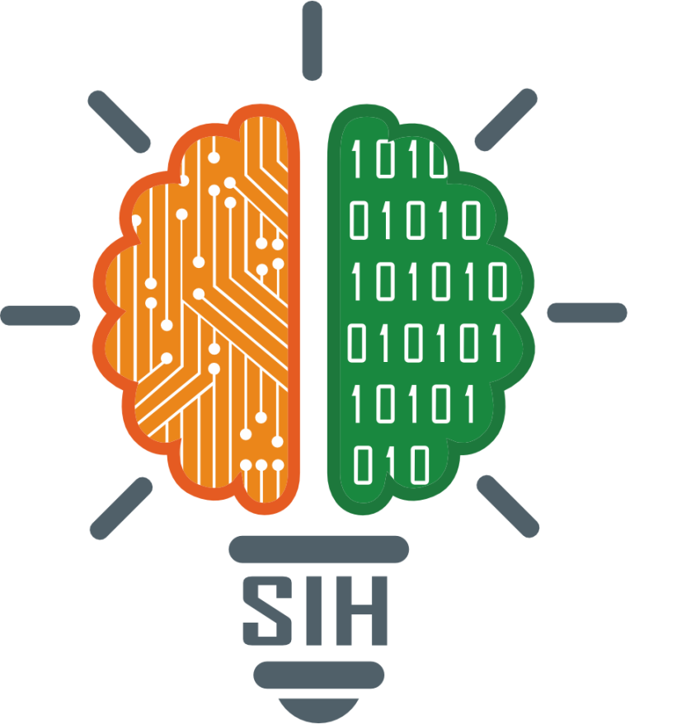
SMART INDIA HACKATHON
2025
Digital Mental Health & Psychological Support System for Students in Higher education
Problem Statement ID- 25092
Title-Digital Mental Health and Psychological Support System for Students in Higher Education
Theme-MedTech/ BioTech/ HealthTech
PS Category- Software
Team Name – Byte Busters

Slide 2
TEAM MEMBERS
Amanullah Bashar (24SCSE1010123)
Abhishek Kumar (24SCSE10111110)
Swarnika Singh (24SCSE1010291)
Anuksha (24SCSE1010588)
Aditya Verma (24SCSE1010174)
Prachi Garg (24SCSE1011161)
2

Slide 3
MindCare- Digital Mental Health Companion
Proposed Solution:- AI- Driven chatbot + mood tracker + counselor dashboard
Students can log moods, journal or talk to chatbot.
AI analyzes emotions (text, voice, face) detects stress, anxiety, depression signals.
Innovation and uniqueness of the solution
Provides self-help modules + connects to counselor when needed.

Slide 4
TECHNICAL APPROACH
Technologies used-
Frontend: React Native or Next.js
Backend: FastAPI (Python) + PostgreSQL
AI/ML: Deepface, custom model (voice emotions)
Methodology-
Student App (Chatbot, mood tracker, journaling)
Emotion AI microservice (Voice Detection)
Counselor Dashboard + Analytics
Gamification + Wearable integration (Future)

Slide 5
FEASIBILITY AND VIABILITY
Feasibility:- i) Can be Developed using open source AI models ii) low cost cloud deployment possible
Challenges:- i) Data Privacy concerns ii) Students may hesitate to use iii) AI misclassification risks.
Strategies:- i) Strick consent & anonymization ii) Awareness campaigns in colleges iii) Human in loop (Counselors validate AI alerts)

Slide 6
IMPACT AND BENEFITS
Impact:- Improves student well-being, reduces dropouts Enables early intervention, saving lives Scalable to universities nationwise
Benefits:-
Social: Better mental health, less stigma
Economics: Reduced counselling costs, improved student performance
Institutional: Data-driven insights for universities.

Slide 7
RESEARCH AND REFERENCES
WHO India- Mental Health Overview
https://www.who.int/india/health-topics/mental-health
National Mental Health Survey of India 2015
https://journals.plos.org/plosone/article?id=10.1371/journal.pone.0205096
MIT News- Deploying ML to improve mental health
https://news.mit.edu/2022/deploying-machine-learning-improve-mental-health-rosalind-picard-0126
DeepFace Official Documentation
https://github.com/serengil/deepface

